Slide 1
CARE Resilience Marker (Revised) 2018 Training Module
Developed by | CARE Climate Change and Resilience Platform (CCRP)
Date | July 2018
Notes:
Question about the PowerPoint Presentation? Please contact CCRP@careinternational.org

Slide 2
Overview
Background and context
The resilience marker step-by-step
Dissemination and use of resilience data
Conclusion and questions
Notes:
The aim of this webinar is two-fold:
Primarily aims to familiarize you with the marker, in order for you to be able to use and apply it with your project team
Secondarily shed some light on the process of:
Developing the revised Resilience Marker
Dissemination, use and analysis of the data

Slide 3
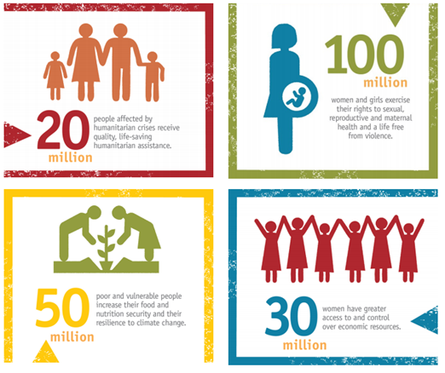
Background & Context
CARE Strategy 2020
Address the underlying causes of vulnerability to overcome the injustice of poverty
CARE and our partners will support 150 million people from the most vulnerable and excluded communities to overcome poverty and social injustice by 2020
By using CARE’s overarching approach of tackling the underlying causes of poverty and social injustice, prioritizing three key approaches in our programs and actions:
Strengthening gender equality and women’s voice
Promoting inclusive governance
Increasing resilience
And playing the following roles:
Humanitarian action and saving lives
Promoting lasting change and innovative solutions
Multiplying impact
Notes:
Increasing Resilience is one of three elements in CARE’s integrated approach which aims to address the underlying causes of poverty and social injustice. In the face of escalating shocks, stresses and an uncertain future, increasing the resilience of communities and individuals goes hand in hand with gender equality and inclusive governance as the pathway out of poverty and to life with dignity. As such, the other two elements are Strengthening Gender Equality and Women’s Voice and Promoting Inclusive Governance.
What does a key approach mean?
CARE aims to increase resilience in all programs and projects, and as such, the approach applies to all four priority outcome areas:
An effective humanitarian response;
The right to sexual, reproductive and maternal health and a life free from violence;
Food and nutrition security and resilience to climate change;
and Women’s access to and control of economic resources.

Slide 4
Background & Context
CARE Resilience Marker Road Map
2015 Resilience was identified as one of the approaches in Program Strategy 2020
2015 PIIRS included question on resilience
2017 Resilience Marker developed
2017 July - September Data collection PIIRS on data Financial Year 2017
2018 April - May Review done on usage and appropriateness Resilience Marker
2018 July New Resilience Marker finalized
2018 July - September Data collection PIIRS on data Financial Year 2018

Slide 5
Background & Context
What is Resilience?
Notes:
Poverty is created and sustained through unequal power relations and the resulting unjust distribution of resources and opportunities, often with a damaging and disproportionate effect on women and girls. . The world is becoming a more turbulent place, with a more extreme and unpredictable changing climate, more frequent natural hazards both large and small, and increased violent conflict affecting more and more people.
For CARE, resilience is about managing risk and dealing with shocks and stresses that negatively influence people’s lives. CARE aims to focus on shocks and stresses that affect groups that exceed individual or household level: e.g. household groups, communities, regions or even entire countries.
According to CARE’s Increasing Resilience theoretical framework, resilience is increased if:
People’s capacities and assets to manage shocks and stresses are built and supported, and
The drivers of risk are reduced, and
These actions are supported by conducive formal or informal rules, plans, policies and legislation that allow individuals and communities to reduce their vulnerability.
See: https://careclimatechange.org/publications/increasing-resilience-theoretical-guidance-document-care-international/

Slide 6
Background & Context
CARE Increasing Resilience Theoretical Framework
Notes:
In 2016, CARE launched its new Resilience Framework, focusing on drivers of risk, building resilience of communities and individuals trough capacities and assets, and supporting the enabling environment. A guidance note was published in Dec 2016, which provides an overview of the key elements for increasing resilience within CARE.
The diagram on this slide can be explained as follows:
• The aim of the increasing resilience approach is to harness the relationship between capacities, drivers of risk, and the enabling environment.
• Underpinning the resilience approach are risk analysis, flexibility, and innovation. These distinguish it from CARE’s other established programming areas.
• People use their capacities and assets to interact with their human and natural environment to better protect and promote people’s rights and safeguard the environment.
https://careclimatechange.org/publications/increasing-resilience-theoretical-guidance-document-care-international/

Slide 7
Background & Context
What is the CARE Resilience Marker? (1)
Self-assessment tool: To what extent is resilience integrated in my project?
Grading System
0 | 1 | 2 | 3 | 4
No resilience integration | Poor resilience integration | Fair resilience integration | Good resilience integration | Excellent resilience integration
2
Notes:
The CARE Resilience Marker allows teams at CARE to self-assess and reflect on how well resilience is integrated into their projects. It provides relevant insights on how risks and vulnerability to shocks and stresses are addressed, and offers opportunities for further reflection as well as for tracking progress on resilience integration over time.
The Resilience Marker provides a score from 0 to 4, ranging from “no resilience integration” up to “excellent resilience integration” for each project assessed.
It’s important to mention here that it is about the integration of resilience in the process (design + implementation), rather than the project impact. We assume that if resilience is properly integrated into the projects design and implementation, this will lead to meaningful impact in terms of actively engaging people in reducing their vulnerabilities to the shocks that affect them (CI Global Indicator 21).
The structure of the Vetting Form has however changed, and does now consist of 6 questions that will add up to a final grade (but we will get into this once we go through the form step-by-step).

Slide 8
Background & Context
Year | Mean |  | Scores (values)
FY18 | Revised Resilience Marker | 0 No resilience integration | 1 Poor resilience integration | 2 Fair resilience integration | 3 Good resilience integration | 4 Excellent resilience integration
FY17 | Resilience Marker | 0 Harmful | 1 Neutral | 2 Sensitive | 3 Responsive | 4 Transformative
FY16 | To what does the project include actions that increase resilience? | Did not include actions | Partially included |  | Fully included
FY15 | To what does the project include actions that increase resilience? | Did not include actions | Partially included |  | Fully included
Notes:
The overall grading system did not change compared to the previous Resilience Marker, this allows us to:
Compare data with the other Markers (Gender Marker + Inclusive Governance Marker)
Compare data on resilience integration over the previous years (optional: in case time allows, show some data/analysis of PIIRS data)

Slide 9
Background & Context
What is the CARE Resilience Marker? (2)
Multiple purposes:
1
2
3
Analysis & Accountability
Quality Threshold
Interdisciplinary Reflection & Learning
Notes:
The Resilience Marker is designed to be used for different purposes.
Foremost, it is designed as an accountability tool, allowing CARE to collect data on the level of resilience integration in the project portfolio and analyse and identify our strengths as well as areas that require improvement and support in applying the “Increasing Resilience” approach.
Additionally, we encourage all CARE members and offices to use the Resilience Marker as a quality threshold to assess the integration of resilience in the design of proposals.
Lastly, the Resilience Marker provides an opportunity for project teams to facilitate reflection and learning and possible adjustments to project implementation to enhance the level of resilience integration.

Slide 10
Background & Context
When to use the CARE Resilience Marker?
The Resilience Marker is an ever evolving tool, which can be applied and/or revised at any of the following steps:
Project design Quality threshold during proposal development + to highlight areas for further resilience integration
Implementation To monitor and assess if resilience is integrated, to identify challenges and possible actions
Final evaluation To evaluate the level of resilience integration and identify lessons learned and best practices
!
Yearly reporting moment (July-September): PIIRS
Notes:
The Resilience Marker can be applied in the following four stages:
project design,
implementation,
mid-term review
final evaluation.
Only the last stage is actually mandatory as per CARE International perspective, as the mark attributed will be reported in the annual Project and Programme Information and Impact Reporting System (PIIRS).
The use of the resilience marker at the other project stages is up to the concerned Country Member Partners or Country Offices own processes and policies, and the vision of the project’s team.
However, it should be noted that reviewing the resilience marker vetting form at several moments of a project’s life cycle gives the opportunity to assess progress, identify challenges, and adjust resilience building practices when needed.

Slide 11
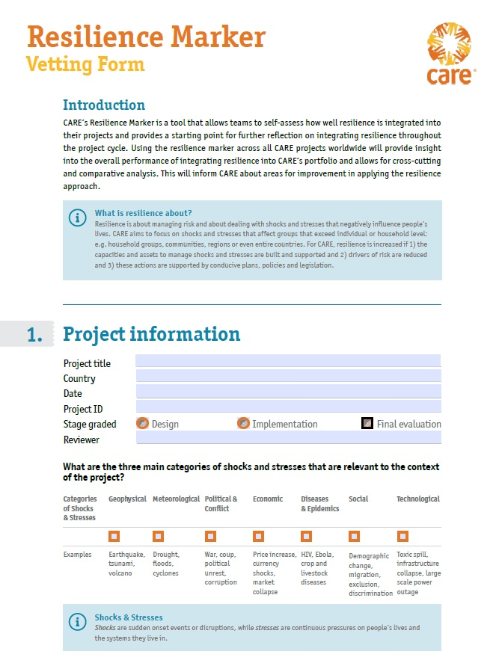
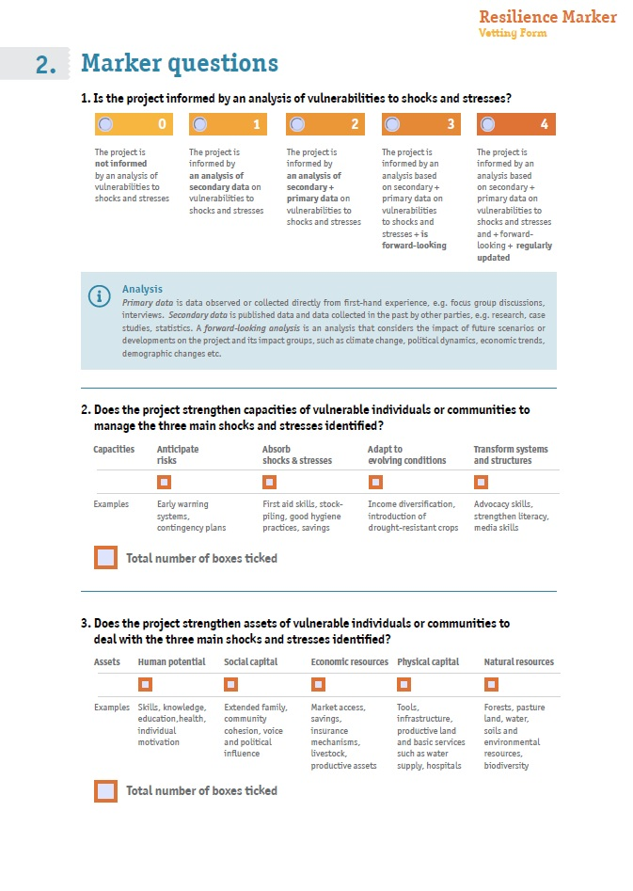
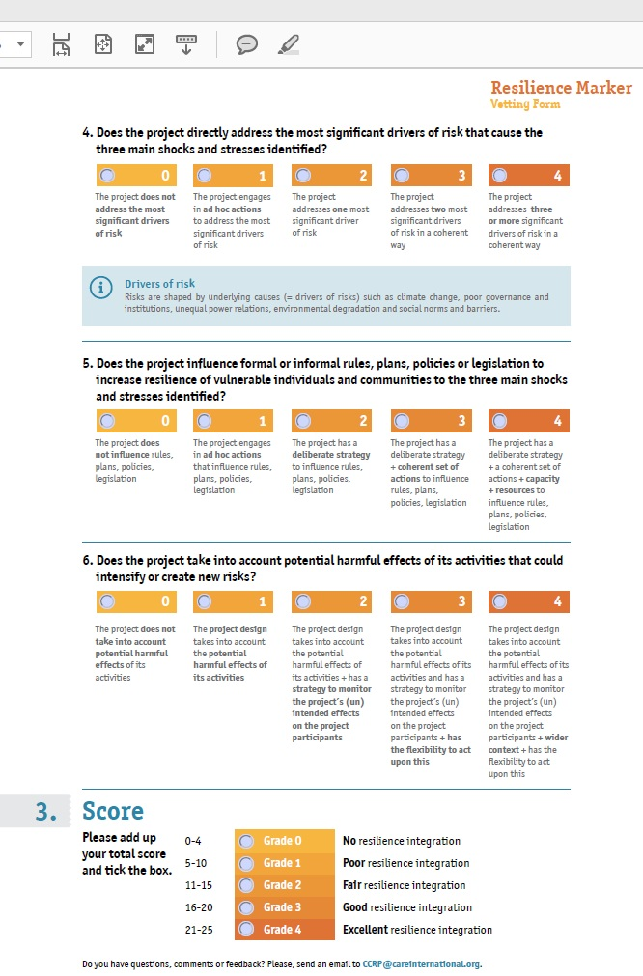
The Resilience Marker Step-by-Step
Material available: careclimatechange.org/tool-kits/cares-resilience-marker/
Notes:
How does the revised Resilience Marker look like?
Be aware that the Resilience Marker now has a different structure from the Gender Marker and Inclusive Governance Marker.
The Vetting Form consists of three pages and has three sections. We will go through all the sections in more detail.
Project Information: We ask you here to complete basic project information
Marker questions: We ask you to answer six questions relating to the integration of resilience in your programming
Score: We ask you add the scores of all six individual questions, which will add up to an overall grade (indicating the level of resilience integration)
The blue boxes provide relevant definitions of terms used in the questions and aim to support you to answer the question meaningfully.
Of course, we will also have the guidance note available – that provides more detailed information.

Slide 12
The Resilience Marker Step-by-Step: Process
Gather available project documents
Review the Resilience Marker Guidance Note
Go through and answer the questions in the Vetting Form
Add justification elements (analysis, supporting documents, links)
Share and discuss with relevant team members, partners, etc.
Overall time:
max. 1 hour
Notes:
Completing the resilience vetting form is a simple process, which does not take long, provided that you have all project data in mind or at hand.

Slide 13
The Resilience Marker Step-by-Step: Project Information (1)
Notes:
The project information section requires the reviewer to complete a variety of questions concerning basic project information:
Title of the project
Country in which the project or program is implemented
The date when you are completing the vetting form
Project ID, e.g. CARE Code
The current stage of the project
Name and ideally title of the reviewer

Slide 14
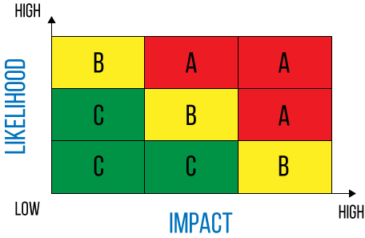
The Resilience Marker Step-by-Step: Project Information (2)
Notes:
This question aims to identify the main categories of shocks and stresses potentially affecting the individuals and communities we work with within the project.
It helps to:
Set the scene and visualize: Helps to answer the question - What are shocks and stresses that the projects and the communities encouter in the project area?
Reflect & Prioritize: What are really the key shocks and stresses.
Important to mention here: Only allowed to select 3 main categories (no more, preferably no less)
In your reflection, it helps to take into account the likelihood (how often) and the severity of the shocks and stressess (what it is the impact)

Slide 15
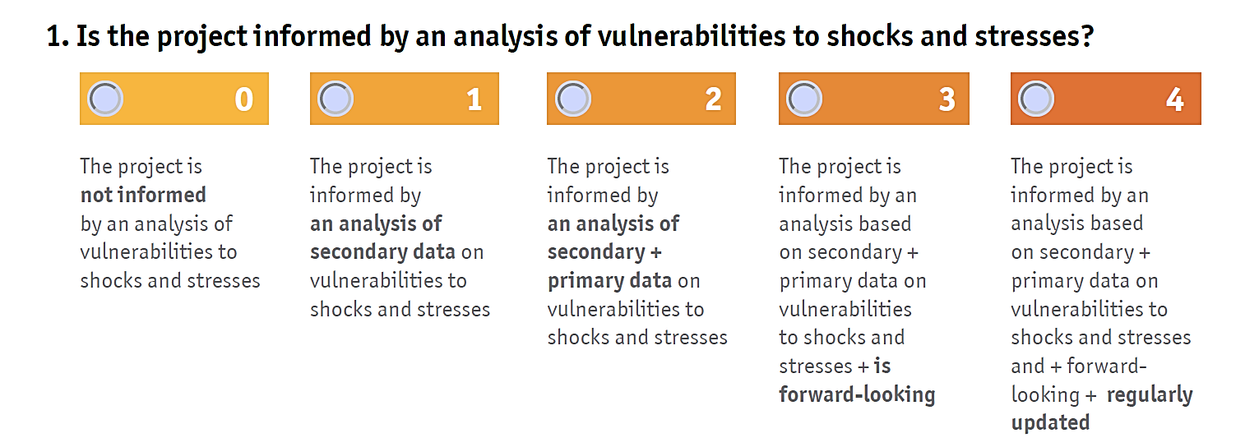
The Resilience Marker Step-by-Step: Marker Questions
Analysis
secondary data
+ primary data
+ forward-looking
+ regularly updated
Notes:
This question addresses the need to understand the risks and vulnerabilities that are at play in your project context. Projects need to base their resilience building interventions on an assessment of vulnerabilities of individuals and communities to the shocks and stresses they face.
A thorough assessment includes a consideration of all three components of CARE’s Increasing Resilience theoretical framework:
Existing capacities and assets
Underlying causes of risks and vulnerability
The enabling environment, made up of formal or informal rules, plans, policies and legislations.
The range of possible answers is on a scale of where each subsequent answer includes an additional element of – in this case – your analysis, ranging from no analysis to a forward-looking, regularly updated analysis that is based on both secondary and primary data.

Slide 16
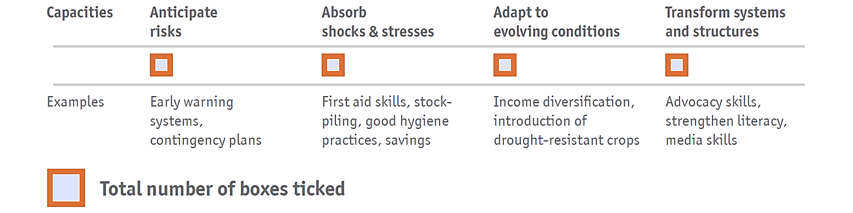
The Resilience Marker Step-by-Step: Marker Questions
Capacities
Notes:
This question addresses the different types of capacities of individuals and communities that a project can strengthen in order to deal with shocks and stresses and to increase resilience.
CARE identifies the following four types of capacities for building resilience:
Anticipate risk: The capacity of individuals or communities to foresee risks and therefore reduce and manage the impact of shocks and stresses that are likely to occur. Anticipating can be understood as being ready for unexpected events through actions that prevent and prepare.
Absorb shock & stresses: The capacity of individuals and communities to accommodate and absorb the immediate impacts of shocks and stresses without significant negative impact on their lives.
Adapt to evolving conditions : The capacity of individuals and communities to change behaviours, practices, lifestyles and livelihood strategies in response to changed circumstances.
Transform systems and structures: The capacity of individuals and communities to influence formal or informal rules, plans, policies and legislations to create systemic and lasting change in behaviours, governance and decision-making structures policies and legislation.
We ask you to tick the boxes of all the capacities that are strengthened in the project. You can add these and fill in the total number of boxed in the square.

Slide 17
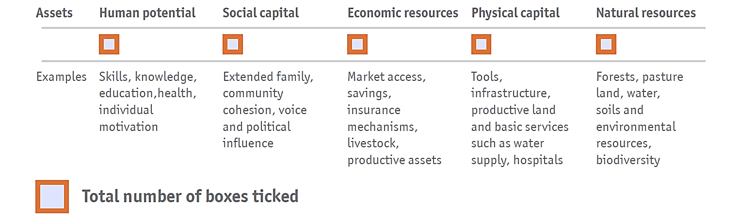
The Resilience Marker Step-by-Step: Marker Questions
Assets
Notes:
This question addresses the different types of assets of individuals and communities that a project can build in order to deal with shocks and stresses and to increase resilience.
CARE identifies the following five types of assets for individuals and communities to become more resilient and act upon their capacities:
Human potential: Assets embodied in individuals and households that facilitate their potential to create or increase personal, social and economic well-being.
Social capital: Social resources that are embedded in formal and informal networks, facilitated by shared norms, values, understanding and mutual trust that create co-operation, exchange and reciprocity within or among groups.
Economic resources: Financial or economic assets or services used to produce goods or services that meet human needs.
Physical capital: Assets consisting of physical materials, (man-made) objects and/or structures.
Natural resources: Renewable and non-renewable assets that grow or occur in the natural environment.
We ask you to tick the boxes of all the capacities that are strengthened in the project. You can add these and fill in the total number of boxed in the square.

Slide 18
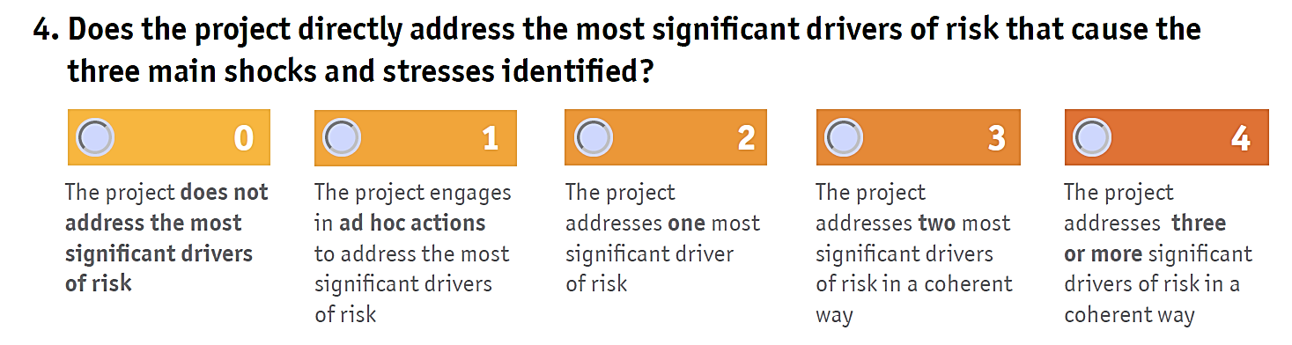
The Resilience Marker Step-by-Step: Marker Questions
Drivers of risk
Notes:
This question addresses the extent to which the project responds to the underlying causes that might potentially result in shocks and stresses.
Shocks and stresses are often the result of a multitude of underlying causes (=drivers of risk), with inter-related and mutually reinforcing connections. Sometimes, certain shocks and stresses can also be drivers of other shocks and stresses. For example: a lack of government regulations leads to overgrazing, which might lead to degraded ecosystems, which potentially leads to social tension and possibly conflicts).
Most of CARE’s projects will not have the opportunity to address all drivers, but systematically addressing a number of drivers in a holistic approach, we believe has a significant impact on the risks that individuals and communities face. The range of possible answers is on a scale of where each subsequent answer includes an additional driver that the project addresses.
CARE commonly encounters the following drivers of risk:
• Climate change
• Poor governance and institutions
• Lack of control over resources
• Limited access to basic services
• Environmental degradation
• Conflict
• Market failure
• Social norms and barriers

Slide 19
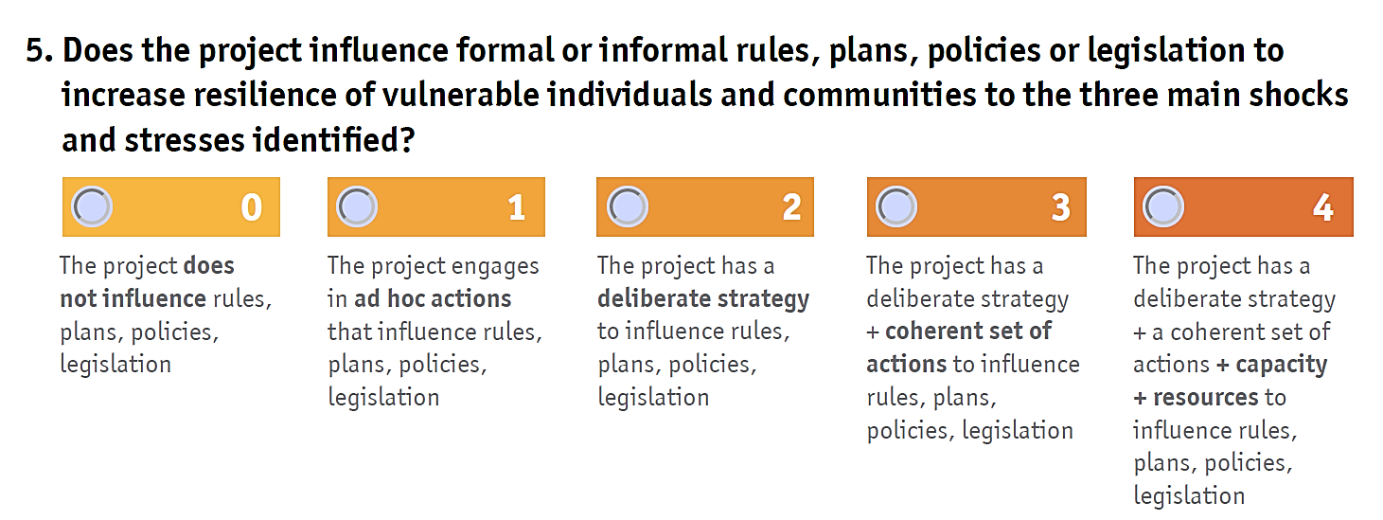
The Resilience Marker Step-by-Step: Marker Questions
Enabling environment
Notes:
This question aims to identify to what extent the project actively aims to influence the enabling environment in relation to the shocks and stresses identified.
The enabling environment is made up of formal and informal rules, plans, policies and/or legislation, from global policy frameworks down to local community-level norms.
The range of possible answers is on a scale of where each subsequent answer includes an additional element or action in your project’s advocacy strategy.
Ad hoc actions: The project has some activities in place related to influencing plans, policies or legislation linked to resilience, but the project doesn’t engage around them in a coherent or integral way.
Deliberate strategy: The project has a strategy with a clear logic or theory of change, identifying advocacy targets and messages, (intermediate) outcomes and means to verify advocacy wins.
Coherent set of actions: The project has a systematic set of activities that jointly work toward achieving the Theory of Change and intended outcomes.
Capacity and resources: The project has staff involved that have the capacities and appropriate skills to fulfil the advocacy work, and have the means and time allocated to fulfil the work.

Slide 20
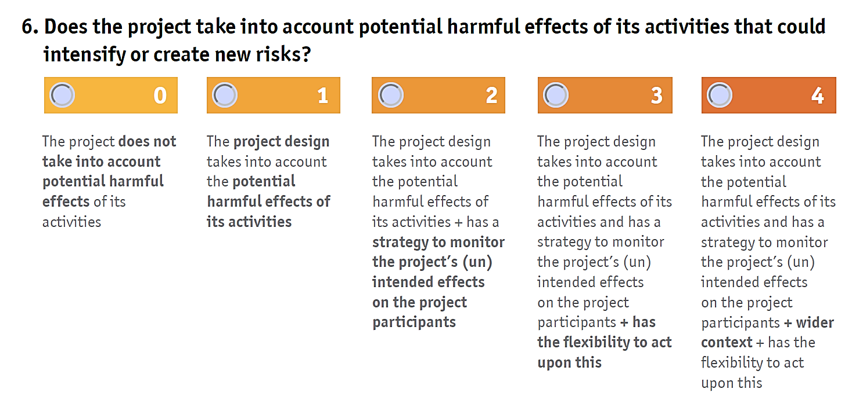
The Resilience Marker Step-by-Step: Marker Questions
Do No Harm
Notes:
This question assesses the extent to which the project is aware of potential harmful or (unintended) effects it causes to vulnerable individuals and communities.
Within CARE, awareness concerning the importance of Do No Harm is prevalent, in particular in relation to conflict and Gender Based Violence. Within the resilience approach, we aim to encourage the integration of structural monitoring of possible negative consequences of our work in relation to creating new or exacerbating existing risks. The range of possible answers is on a scale of where each subsequent answer includes an additional element or action in your project.
Looking at potential harmful effects at design: The potential for harm caused by the intervention has been identified during the design phase, and the project has been designed in such a way to reduce potential harm done.
Monitor the project’s (un)intended effects on the project participants: The project monitors positive and negative change among the project participants on a regular basis.
Flexibility to act: The project has built-in flexibility within budget, activities and staff to accommodate necessary changes based on potential negative effects identified. The project staff is in open dialogue with the donor to allow for flexibility.
Monitor project (un)intended effects on the wider context: The project has a quantitative and qualitative Monitoring, Evaluation and Learning system in place to monitor and measure potential impacts of the project on the wider environment in which the project is implemented.

Slide 21
The Resilience Marker Step-by-Step: Final score
Notes:
The individual scores of the 6 questions add up to an overall grade for the project. This indicates the level of resilience integration in the project.
Count the number of boxes you have ticked and mark the grade accordingly
Provide elements of justification as relevant and available: explanation, supporting documents, links, etc

Slide 22
Dissemination & Use of Resilience Data
How is Resilience Marker data collected?
Resilience data accross CARE is collected on a yearly basis through PIIRS
The Resilience Marker is included in the PIIRS REACH Form
Notes:
Quantitative data collection on the Resilience Marker is done in the PIIRS system, which is completed once a year.

Slide 23
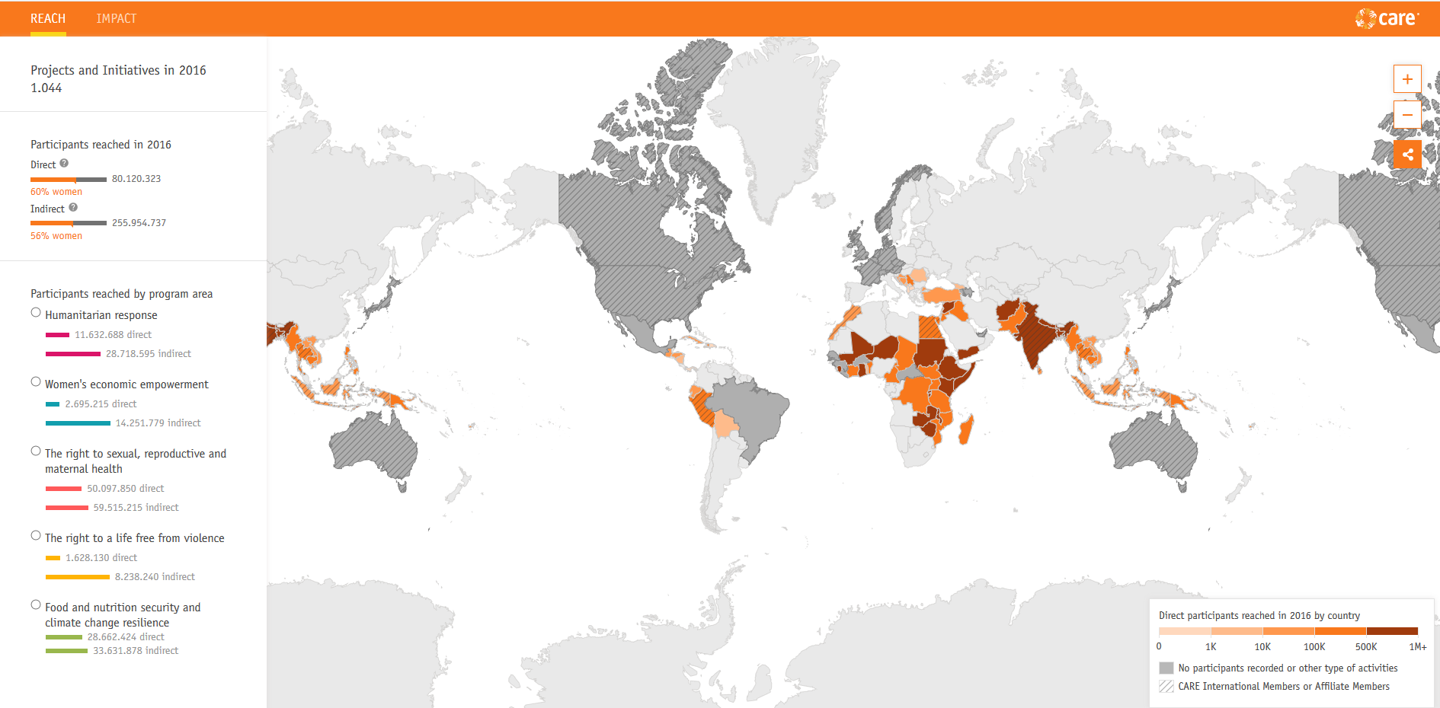
Dissemination & Use of Resilience Data
How is Resilience Marker analyzed & used?
The Resilience Marker data provides insight into the overall performance of integrating resilience into CARE’s portfolio
CARE Interactive REACH & Impact Map
The Resilience Marker data provides a starting point for follow-up discussion and Knowledge Management:
What are best practices in integrating resilience?
Where/in what fields is more support needed?

Slide 24
CARE - Resilience Integration (FY15-17)
Background & Context
Notes:
Use of the Resilience Marker
In 2017, the Resilience Marker has been applied to 82.2% of the total number of reported projects and initatives (950). 169 reported projects and initiatives (18%) have not used the Resilience Marker.
Average Scores (FY15-17): Increased quantity and quality of resilience integration
To start - we do have to point out that, as the Resilience Marker did not exist in FY15 and FY16, the answering categories are different and therefore the variables are not fully comparable. While the Resilience Marker was introduced in FY17, Country Offices were in FY15 + FY16 asked the following question: “To what does the project include actions that increase resilience?”. The table illustrates how we matched the Resilience Marker scores to the answer categories given in FY15+16.
We can however make some general remarks. If we compare the total projects of FY17 to FY15 and FY16 that did report (so taking score 0-4 as 100%), we can conclude that resilience is increasingly integrated in CARE’s projects and initiatives. While in FY15, only 29.7% of the projects did include actions that increase resilience (69.4% in FY16), 87.1% of the projects in FY17 scored a 1 to 4, partially to fully including actions to increase resilience. Not only do more projects integrate resilience, also the quality of integrating resilience is improving: More than a quarter of the projects in FY17 (26,76%) have score a 3 or higher, which can be compared to the 28% (fairly high) in FY16 and 16.7% in FY15.

Slide 25
Background & Context
Resilience Marker Score compared to other Markers
Gender Equality integration
Resilience integration
Inclusive Governance integration
Gender Marker scores
Resilience Marker scores
Inclusive Governance Marker scores
Notes:
Use of the resilience marker
Compared to the use of other markers, we can conclude that the Resilience Marker has some catching up to do: While the Gender Marker is applied in more than 90% of the projects and while the Governance Marker is applied in 86.8% of the projects, in contrast 82.2% of the projects used the Resilience Marker score the level of resilience integration. Also compared to the data of FY17 to FY15 and FY16, we see a slight hick-up (increase) in the percentage of projects which have not used the Resilience Marker (from 22% in FY15 to 6% in FY16 to 17.8% in FY17). Yet we also see a trend of higher ´no marker scores´ amongst the Gender and Inclusive Governance score for FY17. However, considering that the Resilience Marker has just been launched last year and that this year was the first time to collect data on the use of the Resilience Marker, we are hopeful to catch up soon.
Scores
Zooming in on the marker scores, the resilience marker scores comparatively high on score 4 (transformative), especially compared to the inclusive governance marker score (10%). While the share of projects and initiatives being scored as responsive is relatively the same across all markers, we do see that both the gender and the inclusive governance marker have a much higher share of projects and initiatives scoring a two. We see that the share of projects and initiatives which score a 1 (neutral) for the resilience marker is much higher. Next step is to further increase the integration of resilience: We aim to lower the share of projects and initiatives which score a 0 or a 1.

Slide 26
Questions & Answers
Do you have any questions?
Notes:
Open floor for questions.

Slide 27
Support: Email & Skype
?
Do you have any further questions or need further support?
Send your questions to: CCRP@careinternational.org
Add the CCRP team to your Skype for Business contacts:
Wieteke Overbeek (overbeek@carenederland.org)
Wouter Bokdam (wbokdam@carenederland.org)
Post your question in the PIIRS Help Desk: https://join.skype.com/hca8Q0YlO3mb
or send your question to piirs@careinternational.org

Slide 28
CCRP & Resilience Marker Updates
All Resilience Marker material & updates will be available at:
careclimatechange.org/tool-kits/cares-resilience-marker/

